Slide 1


Chukwuemeka Okoli
2nd December 2021

Slide 2

Outline
Executive Summary
Introduction
Methodology
Results
Conclusion
Appendix

Slide 3
Executive Summary
Summary of methodologies
Data Collection through API
Data Collection with Web Scraping
Data Wrangling
Exploratory Data Analysis with SQL
Exploratory Data Analysis with Data Visualization
Interactive Visual Analytics with Folium
Machine Learning Prediction
Summary of all results
Exploratory Data Analysis result
Interactive analytics in screenshots
Predictive Analytics result

Slide 4
Introduction
Project background and context
Space X advertises Falcon 9 rocket launches on its website with a cost of 62 million dollars; other providers cost upward of 165 million dollars each, much of the savings is because Space X can reuse the first stage. Therefore, if we can determine if the first stage will land, we can determine the cost of a launch. This information can be used if an alternate company wants to bid against space X for a rocket launch. This goal of the project is to create a machine learning pipeline to predict if the first stage will land successfully.
Problems you want to find answers
What factors determine if the rocket will land successfully?
The interaction amongst various features that determine the success rate of a successful landing.
What operating conditions needs to be in place to ensure a successful landing program.

Slide 5


Slide 6
Methodology
Executive Summary
Data collection methodology: Data was collected by two means: (i)using SpaceX API.(ii)web scraping from Wikipedia.
Data wrangling: We applied One-hot encoding on categorical variables
Exploratory data analysis (EDA) using visualization and SQL
Interactive visual analysis using Folium and Plotly Dash
Predictive analytics using classification models: We applied different classification models with their best hyperparameters and compared the results for different models

Slide 7
Data Collection
The following techniques were used to collect the required data:
We collected the data using the get request to the SpaceX API,the output of which was decoded into a Json file using .json() function. Next we turned this json output into our desired pandas dataframe using .json_normalize().
We then cleaned the data, checked for missing values and filled the missing values where necessary.
In addition, we performed web scraping from Wikipedia for Falcon 9 launch records with BeautifulSoup.The objective here was to extract the launch records as HTML tables using the BeautifulSoup object and converting it into a dataframe by iterating through the different html tables.

Slide 8
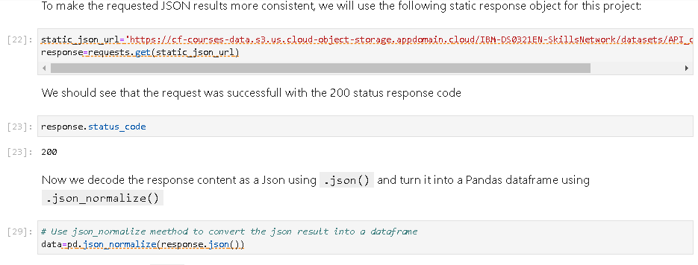
Data Collection – SpaceX API
We used the get request to the SpaceX API to collect data, clean the requested data and performed data wrangling and formatting.
.

Slide 9

Data Collection - Scraping
We applied web scrapping to webscrap Falcon 9 launch records with BeautifulSoup
We parsed the table and converted it into a pandas dataframe.

Slide 10

Data Wrangling
We performed exploratory data analysis and determined the training labels.
We calculated the number of launches at each site, and the number and occurrence of each orbits
We created landing outcome label from outcome column and exported the results to csv.

Slide 11
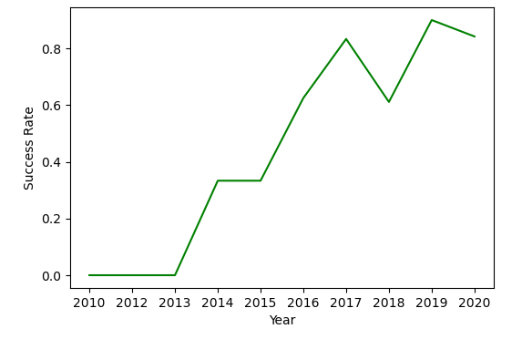
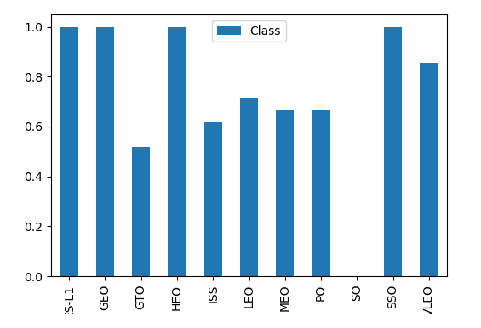
EDA with Data Visualization
We explored the data by visualizing the relationship between flight number and launch Site, payload and launch site, success rate of each orbit type, flight number and orbit type, the launch success yearly trend.

Slide 12
EDA with SQL
We loaded the SpaceX dataset into a PostgreSQL database without leaving the jupyter notebook.
We applied EDA with SQL to get insight from the data. We wrote queries to find out the results to some questions.Some of them are mentioned below.
- The names of unique launch sites in the space mission.
The total payload mass carried by boosters launched by NASA (CRS)
The average payload mass carried by booster version F9 v1.1
The total number of successful and failure mission outcomes
The failed landing outcomes in drone ship, their booster version and launch site names.

Slide 13
Build an Interactive Map with Folium
We marked all launch sites, and added map objects such as markers, circles, lines to mark the success or failure of stage 1 landing for each site on the folium map, where green and red colours represented success and failure respectively.
We assigned the feature launch outcomes (failure or success) to class 0 and 1.i.e., 0 for failure, and 1 for success.
Using the color-labeled marker clusters, we identified which launch sites have relatively high success rate.
We calculated the distances between a launch site to its proximities. We answered some question for instance:
Are launch sites near railways, highways and coastlines.
Do launch sites keep certain distance away from cities.

Slide 14
Build a Dashboard with Plotly Dash
We built an interactive dashboard with Plotly dash
We plotted pie charts showing the total launches by a certain sites
We plotted scatter graph showing the relationship with Outcome and Payload Mass (Kg) for the different booster version.

Slide 15
Predictive Analysis (Classification)
We loaded the data using numpy and pandas, transformed the data, split our data into training and testing.
We built different machine learning models and tune different hyperparameters using GridSearchCV.
We used accuracy as the metric for our model, improved the model using feature engineering and algorithm tuning.
We found the best performing classification model.

Slide 16


Slide 17

Flight Number vs. Launch Site
From the plot, we found that the larger the flight amount at a launch site, the greater the success rate at a launch site.(This may be because the more number of times you carry out the same task , the more better you become at it)
We can also observe that KSC LC 39A and VAPB SLC 4E were not used initially. Therefore they have a higher success rate.

Slide 18

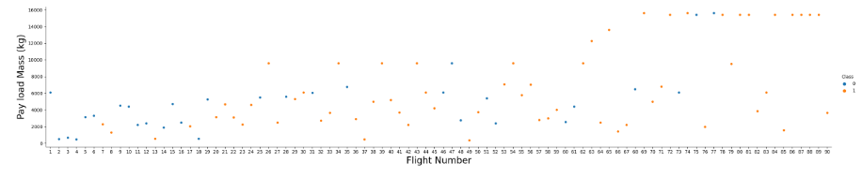
Payload vs. Flight Number
As the Payload mass Increases.the success rate increases .

Slide 19
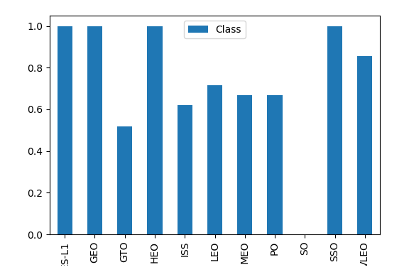
Success Rate vs. Orbit Type
From the plot, we can see that S-L1, GEO, HEO, SSO, had the highest success rate.

Slide 20

Flight Number vs. Orbit Type
The plot below shows the Flight Number vs. Orbit type. We observe that in the LEO orbit, success is related to the number of flights whereas in the GTO orbit, there is no relationship between flight number and the orbit.

Slide 21

Payload vs. Orbit Type
We can observe that with heavy payloads, the successful landing are more for PO, LEO and ISS orbits.

Slide 22

Launch Success Yearly Trend
From the plot, we can observe that success rate since 2013 kept on increasing till 2020.

Slide 23

Important Outcomes of SQL queries:
4 unique launch site names.
Total Payload carried by boosters from NASA is 44596 kg.
The average payload mass carried by booster version F9 v1.1 as 2534.66kg
The first successful landing outcome on ground pad occurred on 1st March 2013.
We found out 4 booster versions with succesful landing which had a payload mass between 4000kg and 6000kg.
We found out the total number of successes as 100 and the total number of failures as 1.
We found out the booster versions for rockets carrying maximum payload.

Slide 24


Slide 25

All launch sites global map markers

Slide 26

Markers showing launch sites with color labels

Slide 27

Launch Site distance to landmarks

Slide 28


Slide 29

Pie chart showing the success percentage achieved by each launch site

Slide 30

Pie chart showing the Launch site with the highest launch success ratio

Slide 31

Scatter plot of Payload vs Launch Outcome for all sites, with different payload selected in the range slider

Slide 32


Slide 33

Classification Accuracy
The decision tree classifier is the model with the highest classification accuracy

Slide 34

Confusion Matrix
The confusion matrix for the decision tree classifier shows that the classifier can distinguish between the different classes. The major problem is the false positives .i.e., unsuccessful landing marked as successful landing by the classifier.

Slide 35
Conclusions
We can conclude that:
The larger the flight amount at a launch site, the greater the success rate at a launch site.
Launch success rate started to increase in 2013 till 2020.
Orbits ES-L1, GEO, HEO, SSO, VLEO had the most success rate.
KSC LC-39A had the most successful launches of any sites.
The Decision tree classifier is the best machine learning algorithm for this task.

Slide 36


